Slide 1

Exploring Neighborhoods In & Out Toronto
Arash Esmaeili-Rizi

Slide 2
Introduction
Almost a year has passed since the World Health Organization (WHO) declared Covid-19 a pandemic. Hundreds of millions of people have lived through lockdowns and city of Toronto is no different. Many of people are working from home and there is no need for them to commute. Due to this reason, there is no need for employees to be close to their office or be located close to hubs and city cores such as downtown. Covid-19 is reshaping our lives.

Slide 3
Introduction
I will be looking at the issue of housing and how the pandemic has standardized remote work, and what that might mean. Will we go to the office again – and, if so, how often? Since there is no need for people to be located close to their office and most people especially located in small apartments in downtown are deciding to move further away. Some of these employees are parents and have kids or pets. Prior to moving it will be good for these employees to look at neighborhoods that is either similar or has the necessary things they need such as school, university, trails and park, library, restaurants.

Slide 4
Target Audience
Parents that want to live in a neighborhood other than downtown and has almost most all the things they currently have.
Young employees that want to live in a neighborhood other than downtown which is cheaper but at the same time has good bars and restaurants or in general night life.
Realtors that want general information to sell a house to their clients.

Slide 5
Data
Wikipedia: “https://en.wikipedia.org/wiki/List_of_postal_codes_of_Canada:_M”
Geonames: “http://www.geonames.org/postal-codes/CA/ON/ontario.html”
Foursquare’s explore API

Slide 6
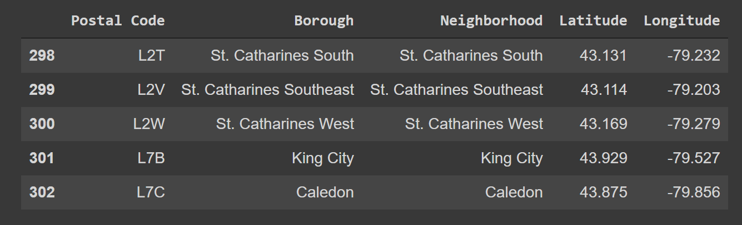
Data
Data is extracted, cleaned and wrangled to get the data frame below based on Neighborhood, postal code and their Lat and Long

Slide 7
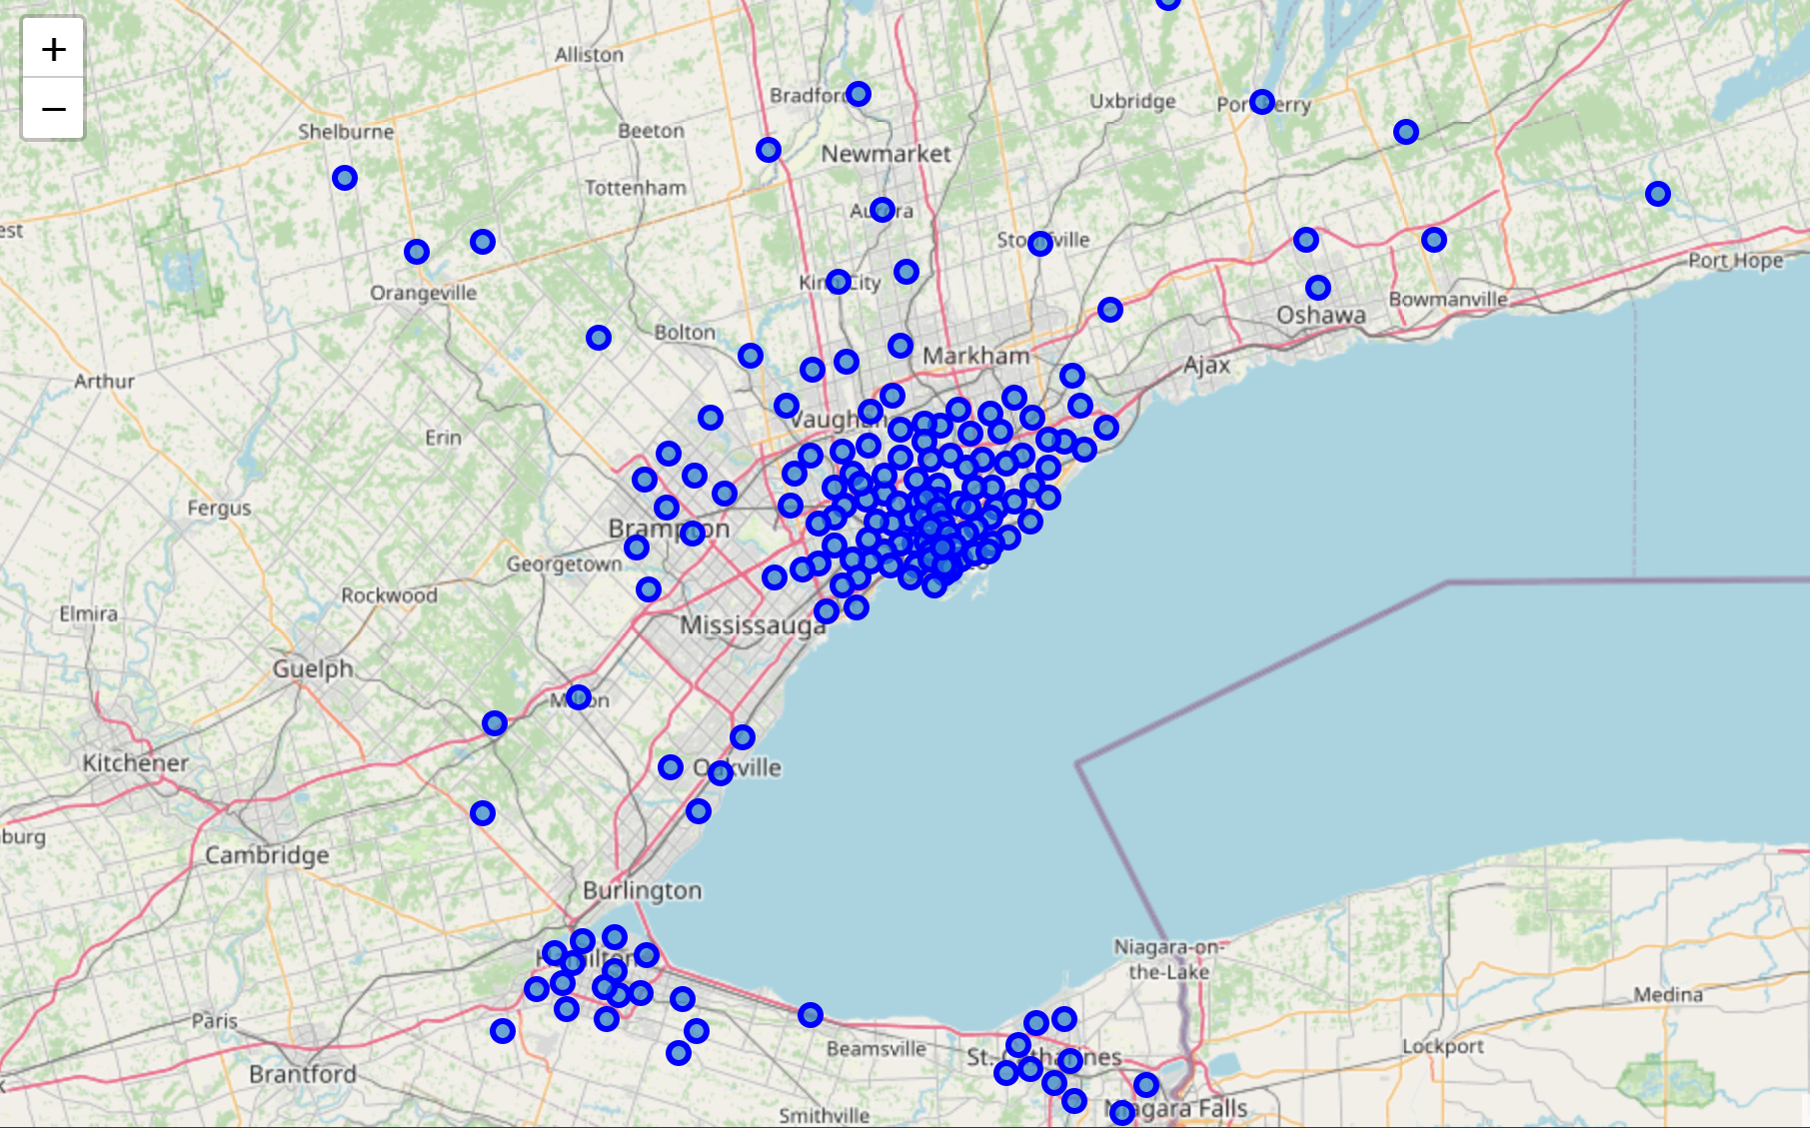
Methodology
Information of the neighborhoods are obtained from Forsquare API and Data is plot using Folium. K-means clustering is used to cluster these neighborhoods.

Slide 8
Result
Clusters is red represents restaurants and coffee shops.
Clusters is purple represents park and playgrounds with some restaurants.
Clusters is blue represents trail and camps.
Clusters is green represents sport courts and restaurants.
Clusters is orange represents construction and landscaping.
As it can been by the map people are moving out towards Orangeville since construction is happening there a lot it is also cheaper. Neighborhoods such as Etobicoke are good since they have red color for restaurants and coffee shops for adults which downtown as but as a plus it has green color as well which is good for families since it has sport courts.
Areas such as Brampton has a lot to offer as well since it has few colors in it. Overall this analysis can be used for people to see what’s a good alternative to Toronto for them

Slide 9
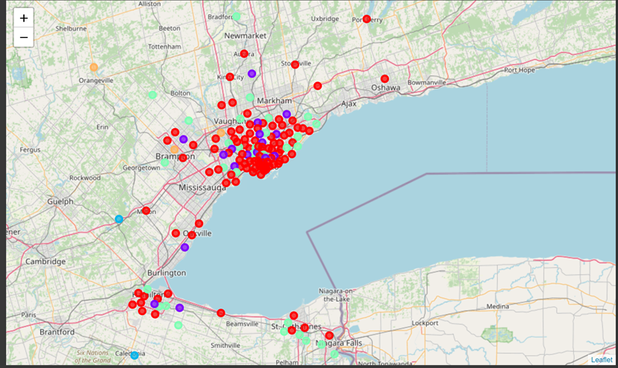
Result

Slide 10
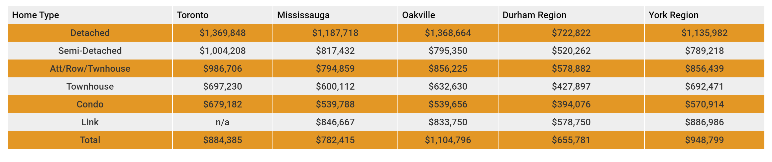
Discussion
As it can be seen in the above map some neighborhoods such as Newmarket, Scarborough, Markham, Oakville, Orangeville and Brampton borough will provide less competition in terms of price and house sizes for people moving in.
Factors such as population, ethnicity safety are not included in this analysis.
For example, the table below from https://www.getwhatyouwant.ca/ shows the price of properties in 2019 in different regions. This analysis is showing that if other neighborhoods have almost the same characteristics in terms of venues why not move out to other regions.

Slide 11
Conclusion
Overall analysis shows that the results can be improved if more time, data, and knowledge is put into it. However, we can use this project to analysis any scenario such as moving to a new neighborhood and comparing it to the current residing neighborhood. Such as the current pandemic scenario that people are moving out of town or to the suburbs. As a result it is observed that in Toronto people are leaving and the number of vacant condos are more than anytime before.
Some new orange neighborhoods such as Orangeville can also be seen in this analysis which indicated construction and landscaping. In other words people are moving there.

